Slide 1
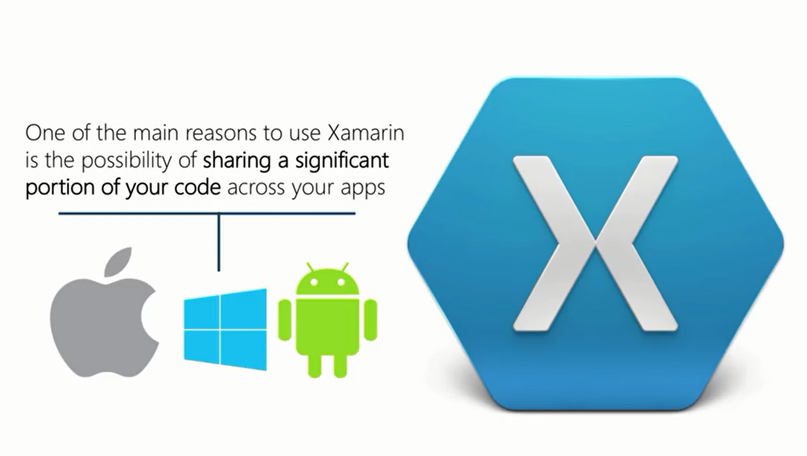

Slide 2


Slide 3


Slide 4
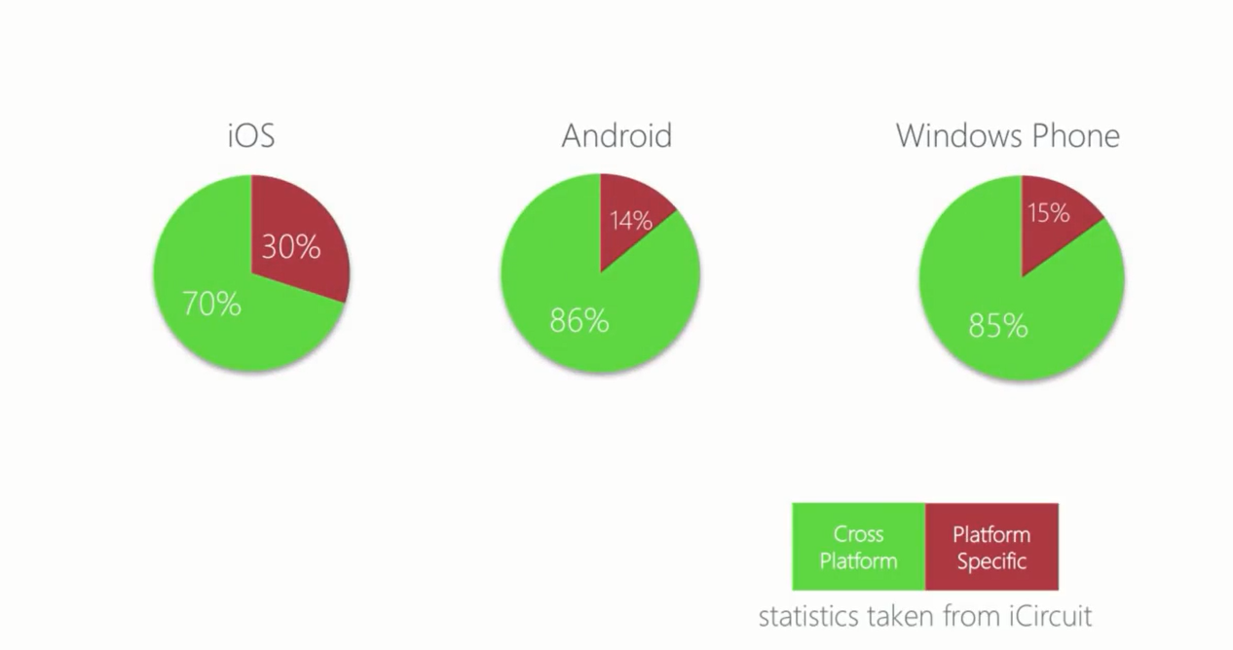

Slide 5
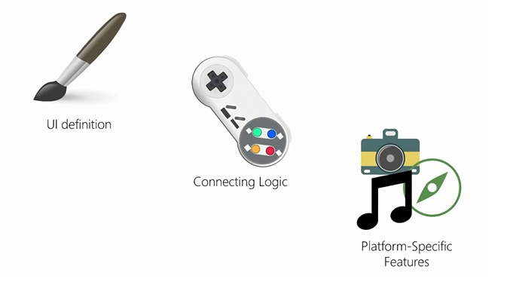

Slide 6


Slide 7
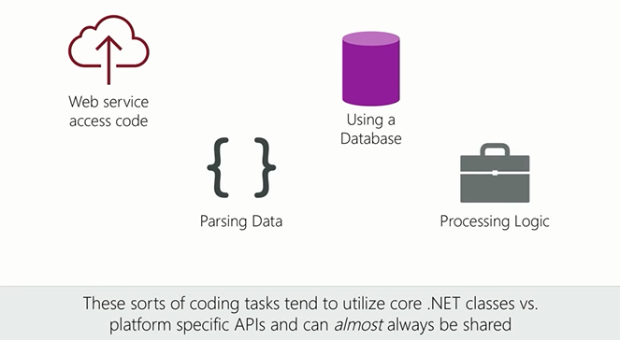

Slide 8
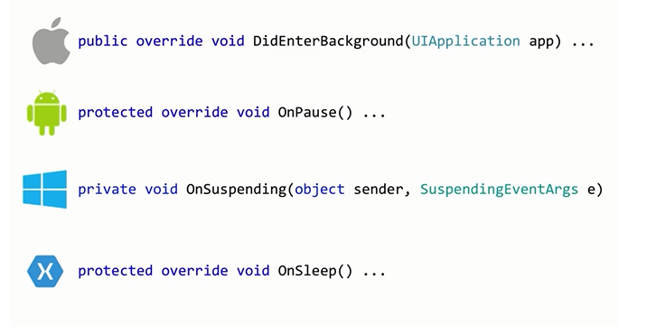

Slide 9
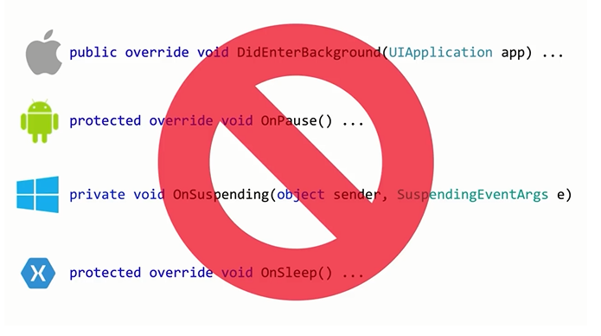

Slide 10
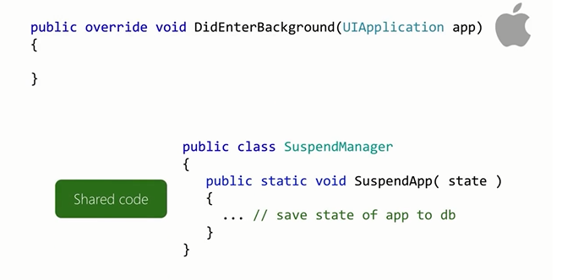

Slide 11
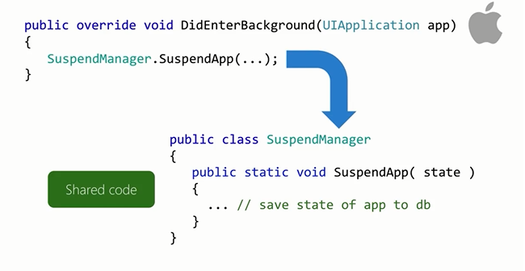

Slide 12
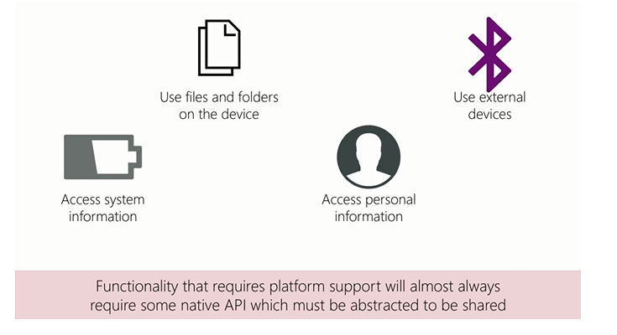

Slide 13
Shared components
Url | Descripción
Xamarin.Social | The Xamarin.Social component provides an abstraction for popular social networking frameworks such as Facebook and Twitter.
Xamarin.Auth | Xamarin.Auth provides a cross-platform implementation for client-side OAuth interactions.
Xamarin.Mobile | Xamarin.Mobile provides an abstraction for common mobile services such as the camera.
Open source plugins | A big list of community-created cross-platform plug-ins.
.NET Foundation | The .NET Foundation has a bunch of open-source code.
NuGet | NuGet is the place to find shared binary components

Slide 14
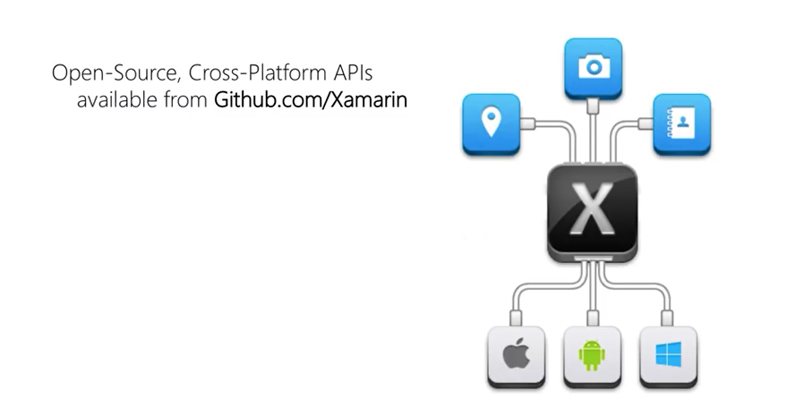

Slide 15
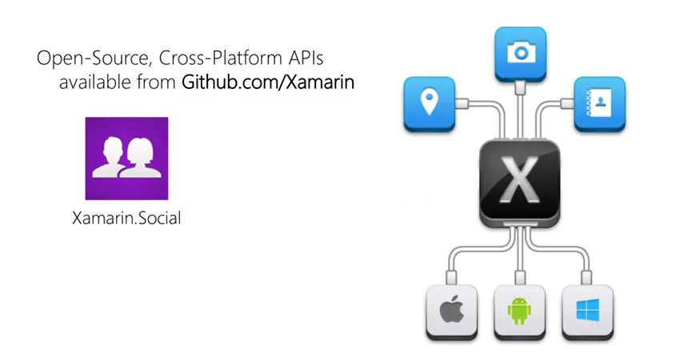

Slide 16
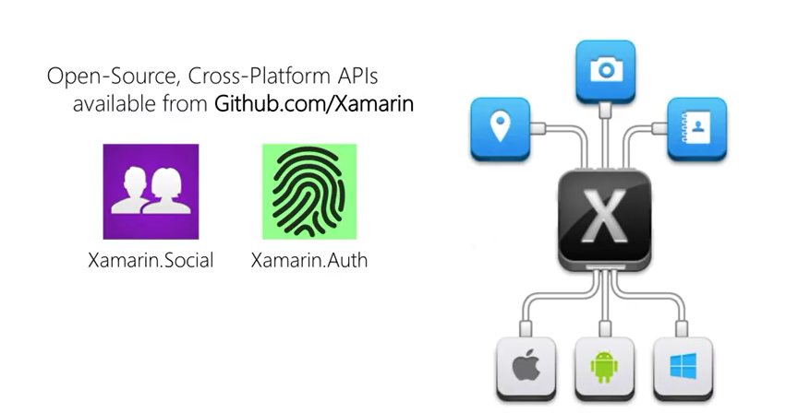

Slide 17
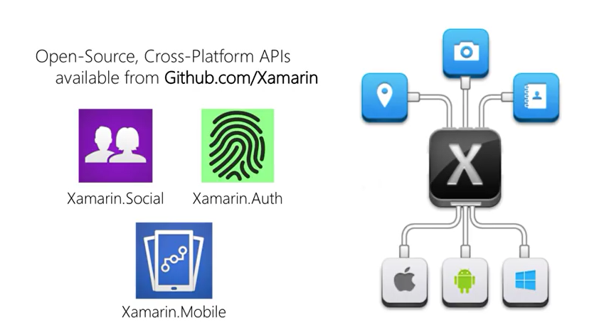

Slide 18
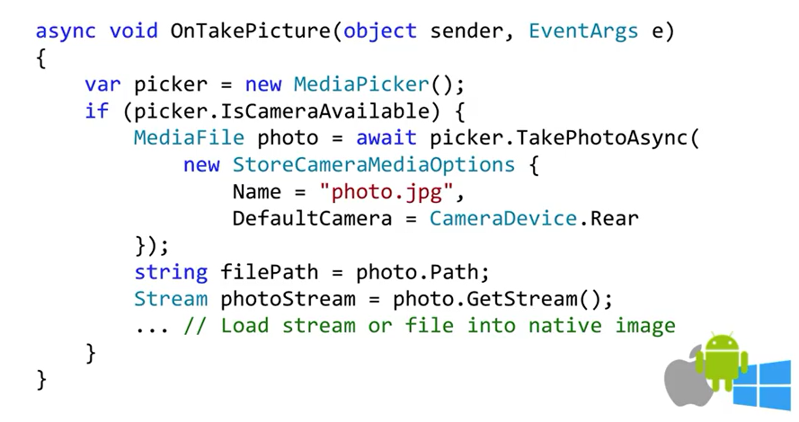

Slide 19


Slide 20
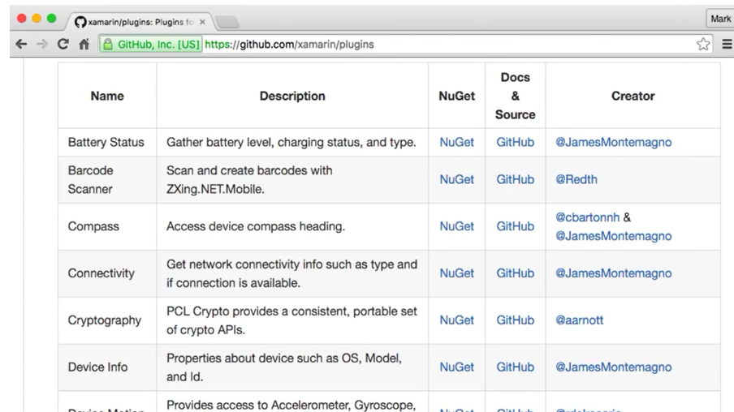

Slide 21


Slide 22
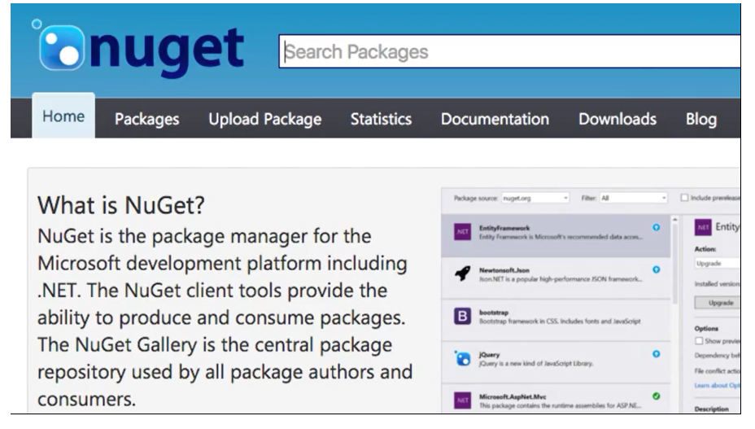

Slide 23
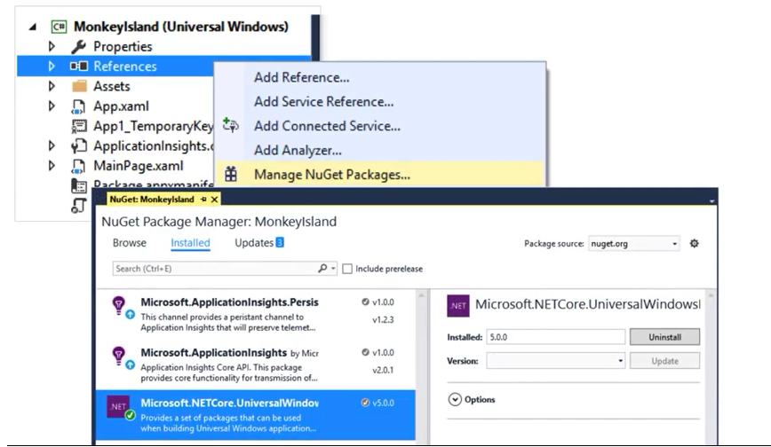

Slide 24
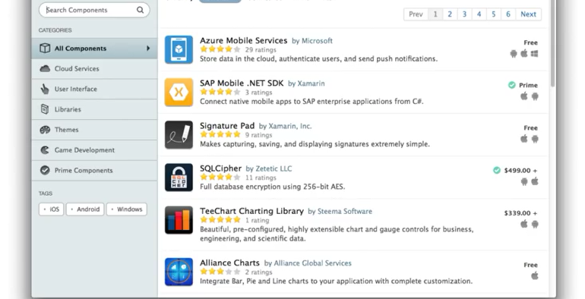

Slide 25


Slide 26


Slide 27
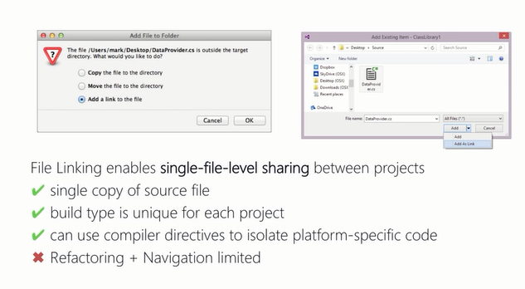

Slide 28
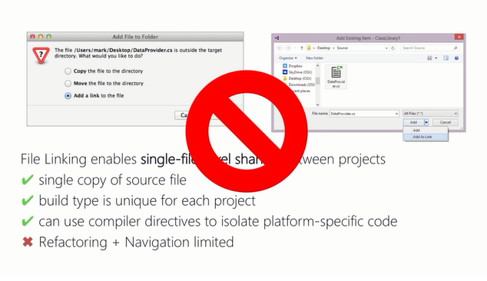

Slide 29
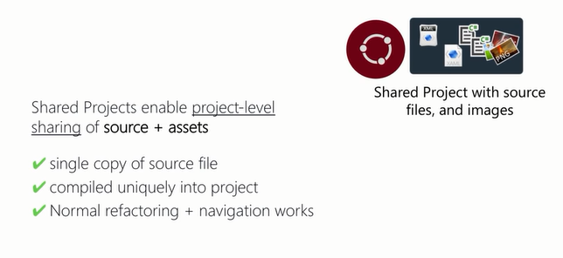

Slide 30
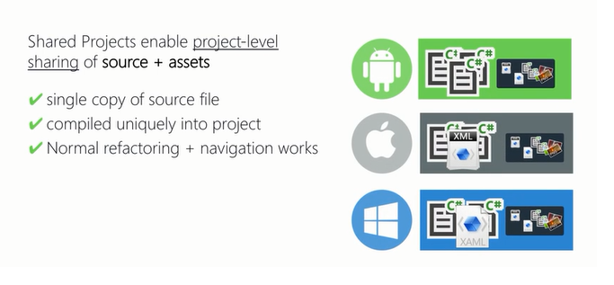

Slide 31
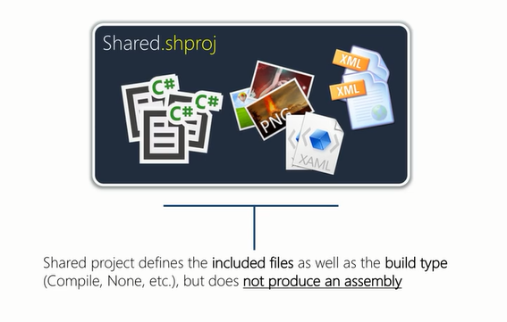

Slide 32
